Slide 1
INTRODUCTION TO COMPUTING
Course Code: CCINCOM/L
Binary Search Tree (BST)
Joseph Marvin R. Imperial
Faculty
Department of Computer Science
College of Computing and Information Technologies (CCIT)
National University
Joseph Marvin R. Imperial
DATA STRUCTURES AND ALGORITHMS
NU College of Computing and Information Technologies
Course Code: CCDATRCL

Slide 2
Binary Search Tree
Binary search tree is a data structure that quickly allows us to maintain a sorted list of numbers.
It is called a binary tree because each tree node has maximum of two children.
It is called a search tree because it can be used to search for the presence of a number in O(log(n)) time.
Joseph Marvin R. Imperial
DATA STRUCTURES AND ALGORITHMS
NU College of Computing and Information Technologies
Course Code: CCDATRCL

Slide 3
BST Rules
A BST is a binary tree where each node has a comparable key (and an associated value) and satisfies the restriction that:
The left subtree of a node contains only nodes with keys lesser than the node’s key (L < P)
The right subtree of a node contains only nodes with keys greater than the node’s key (P < R)
The left and right subtree each must also be a binary search tree. There must be no duplicate nodes.
Joseph Marvin R. Imperial
DATA STRUCTURES AND ALGORITHMS
NU College of Computing and Information Technologies
Course Code: CCDATRCL

Slide 4
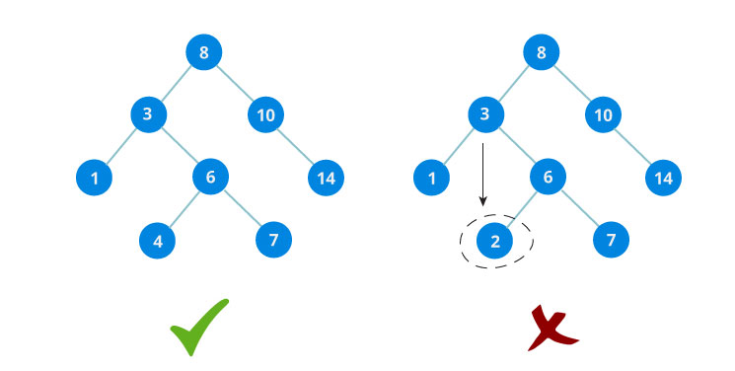
Example
Joseph Marvin R. Imperial
DATA STRUCTURES AND ALGORITHMS
NU College of Computing and Information Technologies
Course Code: CCDATRCL

Slide 5
Notes
Note that the arrangement of which part (left or right) will store the greater, lesser value can be interchanged.
Unlike our usually binary tree, we’ll let BST operations connect nodes recursively and appropriately based on their keys / values.
To make the discussion simpler in this class, we’ll disregard duplicates.
Joseph Marvin R. Imperial
DATA STRUCTURES AND ALGORITHMS
NU College of Computing and Information Technologies
Course Code: CCDATRCL

Slide 6
BST Operations
search(node, key) − searches an element in the tree.
insert(node, key) − inserts an element in the tree
pre-order traversal() − traverses a tree in a pre-order manner.
in-order traversal() − traverses a tree in an in-order manner.
post-order traversal() − traverses a tree in a post-order manner.
Joseph Marvin R. Imperial
DATA STRUCTURES AND ALGORITHMS
NU College of Computing and Information Technologies
Course Code: CCDATRCL

Slide 7
search(node, key) operation
node – the root key – value to be searched
A recursive algorithm to search for a key in a BST which follows the recursive structure:
If the tree is empty, we have a search miss.
If the search key is equal to the key at the root, we have a search hit.
Otherwise, we search (recursively) in the appropriate subtree.
Joseph Marvin R. Imperial
DATA STRUCTURES AND ALGORITHMS
NU College of Computing and Information Technologies
Course Code: CCDATRCL

Slide 8
search(node, key) operation
Joseph Marvin R. Imperial
DATA STRUCTURES AND ALGORITHMS
NU College of Computing and Information Technologies
Course Code: CCDATRCL

Slide 9
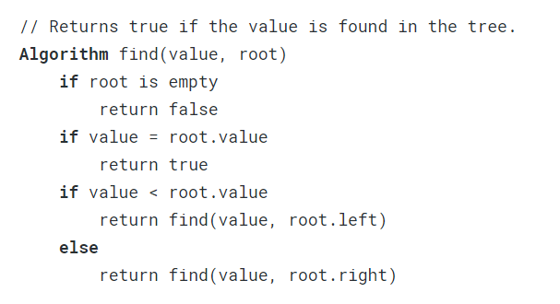
search(node, key) pseudocode
Joseph Marvin R. Imperial
DATA STRUCTURES AND ALGORITHMS
NU College of Computing and Information Technologies
Course Code: CCDATRCL

Slide 10
insert(key) operation
key – value to be inserted
A recursive algorithm to for inserting a key in a BST while maintaining a sorted structure:
if the new node's value is lower than the current node’s, we go to the left child
if the new node's value is greater than the current node’s, we go to the right child
when the current node is null, we've reached a leaf node and we can insert the new node in that position
Joseph Marvin R. Imperial
DATA STRUCTURES AND ALGORITHMS
NU College of Computing and Information Technologies
Course Code: CCDATRCL

Slide 11
insert(key) operation
Joseph Marvin R. Imperial
DATA STRUCTURES AND ALGORITHMS
NU College of Computing and Information Technologies
Course Code: CCDATRCL

Slide 12
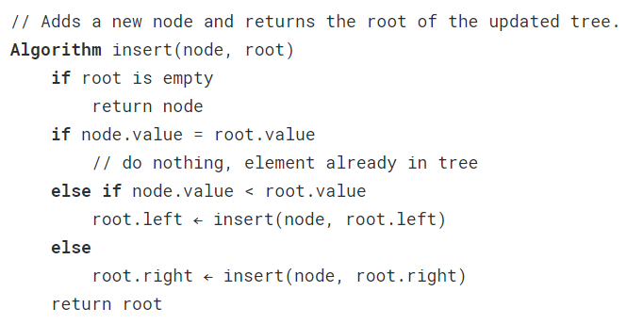
insert(key) pseudocode
Joseph Marvin R. Imperial
DATA STRUCTURES AND ALGORITHMS
NU College of Computing and Information Technologies
Course Code: CCDATRCL

Slide 13
Try
Construct a binary search tree using the data:
11, 6, 8, 19, 4, 10, 5, 17, 43, 49, 31
Joseph Marvin R. Imperial
DATA STRUCTURES AND ALGORITHMS
NU College of Computing and Information Technologies
Course Code: CCDATRCL

Slide 14
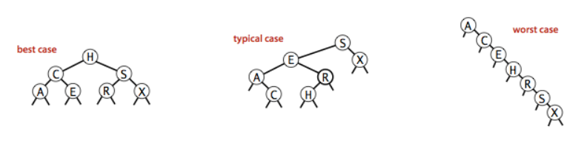
Analysis
The running times of algorithms on binary search trees depend on the shapes of the trees, which, in turn, depends on the order in which keys are inserted.
Joseph Marvin R. Imperial
DATA STRUCTURES AND ALGORITHMS
NU College of Computing and Information Technologies
Course Code: CCDATRCL

Slide 15
delete(key) operation
A recursive algorithm to find the node to be deleted. After finding the node, deletion has three cases:
a node has no children – this is the simplest case; we just need to replace this node with null in its parent node
a node has exactly one child – in the parent node, we replace this node with its only child.
a node has two children – this is the most complex case because it requires a tree reorganization. Replace the node with its next node in in-order traversal.
Joseph Marvin R. Imperial
DATA STRUCTURES AND ALGORITHMS
NU College of Computing and Information Technologies
Course Code: CCDATRCL

Slide 16
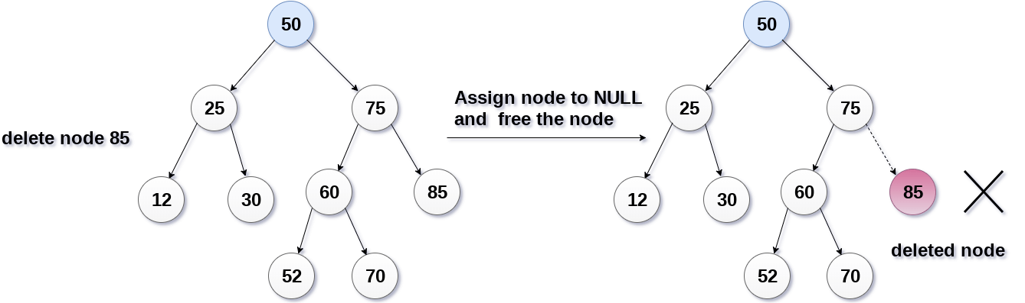
Case 1: A node has no children
Joseph Marvin R. Imperial
DATA STRUCTURES AND ALGORITHMS
NU College of Computing and Information Technologies
Course Code: CCDATRCL

Slide 17
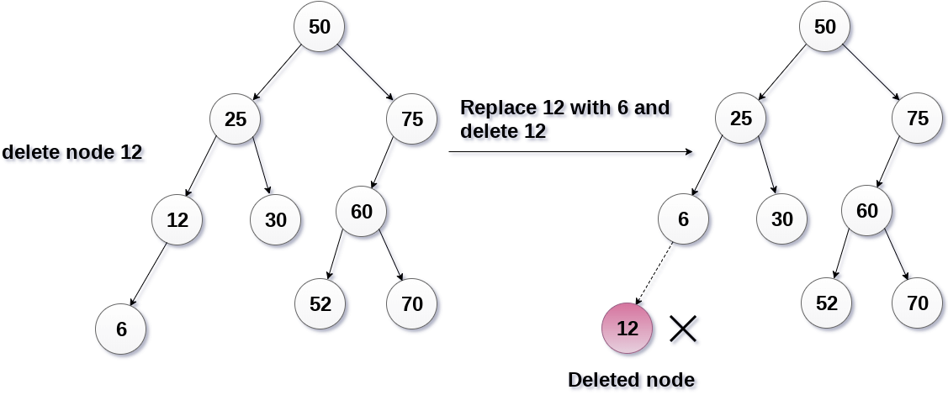
Case 2: A node has only one child
Joseph Marvin R. Imperial
DATA STRUCTURES AND ALGORITHMS
NU College of Computing and Information Technologies
Course Code: CCDATRCL

Slide 18
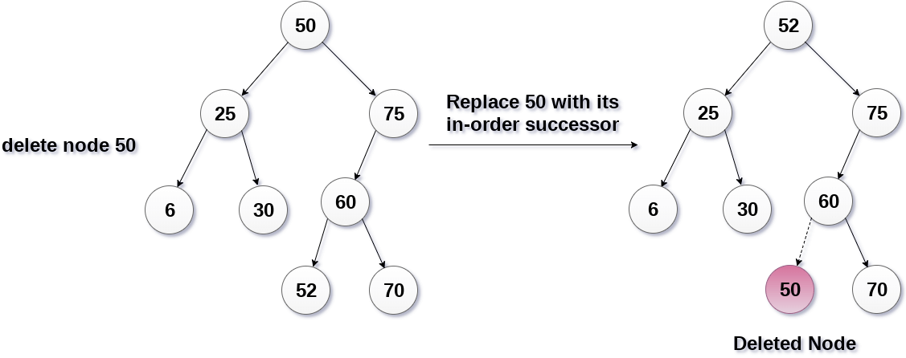
Case 3: A node has two children
Joseph Marvin R. Imperial
DATA STRUCTURES AND ALGORITHMS
NU College of Computing and Information Technologies
Course Code: CCDATRCL

Slide 19
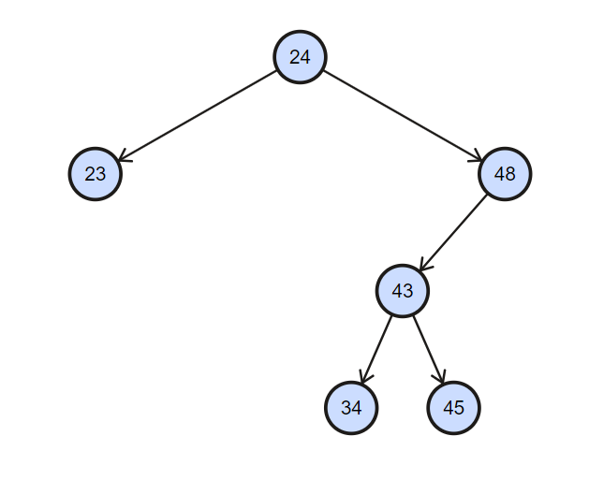
delete node 48
Joseph Marvin R. Imperial
DATA STRUCTURES AND ALGORITHMS
NU College of Computing and Information Technologies
Course Code: CCDATRCL

Slide 20
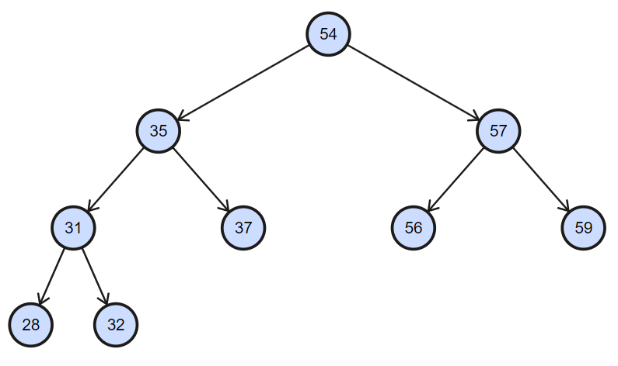
delete node 35
Joseph Marvin R. Imperial
DATA STRUCTURES AND ALGORITHMS
NU College of Computing and Information Technologies
Course Code: CCDATRCL

Slide 21
References
Binary Search Tree - Princeton University: https://algs4.cs.princeton.edu/32bst/
Binary Search Tree – Programmiz: https://www.programiz.com/dsa/breadth-first-search-tree
Joseph Marvin R. Imperial
DATA STRUCTURES AND ALGORITHMS
NU College of Computing and Information Technologies
Course Code: CCDATRCL

